Slide 1
FIBER OPTICS
B.Sc. (Semester -3)
Subject : PHYSICS
Course : US03CPHY01
UNIT : 4
Presented by : Dr. P. M. Patel

Slide 2
Introduction
It was demonstrated by a British Physicist John Tyndall in 1870
He state that light can be guided along the curve of a stream of water.
Due to this total internal reflections light gets confined to the water stream and the stream appears luminous.
A luminous water stream is consider an optical fiber.
In 1950s , the transmission of images through optical fibers was realized in practice.

Slide 3
Hopkins and Kapany developed the flexible fiberscope, which was used by the medical word and viewing the interior of human body.
The Kapany has assign the term fiber optics.
In 1960, it was established that light could be guided by a glass fiber.
In 1966 Charles Kao and George Hockham proposed the transmission of information over glass fiber.
In 1970 corning glass works produced low-loss glass fibers.
The invention of solid state lasers in 1970 made optical communications practicable.

Slide 4
Commercial communication systems based on optical fibers are widely used in other areas.
Fiber-scopes made of optical fibers are widely used in a variety of forms in medical diagnostics.
Sensors for detecting electrical, mechanical, thermal energies are made using optical fibers.
Fiber optics is a technology in which signals are converted from electrical to optical signals, transmitted through a thin glass fiber and reconverted into electrical signals.

Slide 5
Optical Fiber:
Definition: An optical fiber is a cylindrical wave guide made of transparent dielectric, (glass or clear plastic), which guides light waves along its length by total internal reflection.
It is very thin like human hair, approximately 70µm or 0.003 inch diameter.
The thin strand of a metal is called a wire and a thin strand of dielectric materials is called a Fiber.

Slide 6
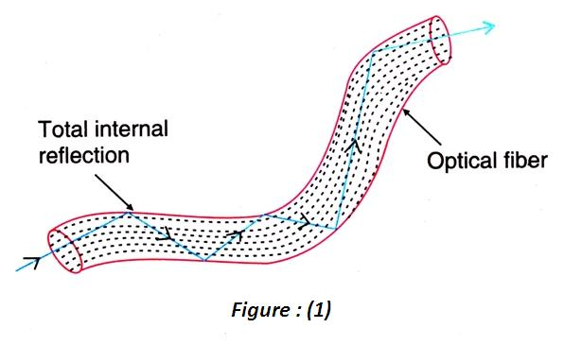

Slide 7
Principle: Light propagate in optical fiber from one of its ends to the other end is based on the principle of total internal reflection.
When light enters one end of the fiber, it undergoes successive total internal reflection from side walls and travels down the length of the fiber along a zigzag path
A small fraction of light may escape through sidewalls but a major fraction emerges out from the exit end of the fiber
Light can travel through fiber even if it is bent.

Slide 8
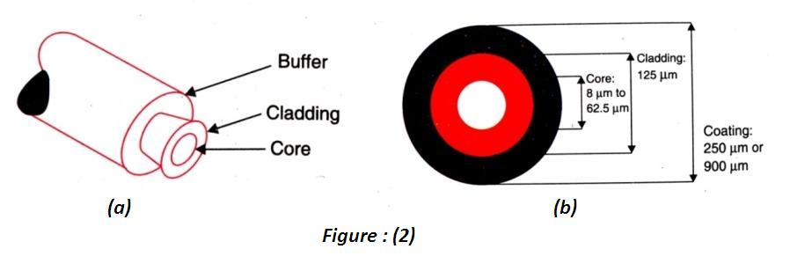
Structure: A practical optical fiber is cylindrical in shape.

Slide 9
It has in general three coaxial regions
Core:
The innermost cylindrical region is the light guiding region known as the core.
In general the diameter of the core is of the order of 8.5 µm to 62.5 µm
Cladding:
The core is surrounded by a coaxial middle region known as the cladding.
The diameter of the cladding is of the order of 125 µm.
The refractive index of cladding ( ) is always lower than that of core (

Slide 10
Light launched into the core and striking the core-to-cladding interface at angle greater than critical angle will be reflected back into the core.
When the angles of incidence and reflection are equal, the light will continue to rebound and propagate through the fiber.

Slide 11
Buffer:
The outermost region is called the sheath or a protective buffer coating.
It is a plastic coating given to the cladding for extra protection.
This coating is applied during the manufacturing process to provide physical and environmental protection for the fiber.
The buffer is elastic in nature and prevents abrasions.
The coating vary in size from 250 µm or 900 µm.

Slide 12
In short
  Core is the inner light-carrying member
  Cladding is the middle layer-which serves to confine the light to the core.
  Buffer coating surround the cladding, which protects the fiber from physical damage and environmental effects.

Slide 13
Necessity for Cladding:
The actual fiber is very thin and light entering a bare fiber will travel along the fibre through repeated total internal reflections at the glass-air boundary.
However , bare fibers are used only in certain applications.
For use in communications and some other applications, the optical fibre is provided with a cladding.
The cladding maintains uniform size of the fibre, protects the walls of the fibre from chipping, and reduces the size of the cone of light that will be trapped in the fibre.

Slide 14
The cladding performs the following important functions:
Keeps the size of the fibre constant and reduces loss of light from the core into the surrounding air.
Protects the fibre from physical damage and absorbing surface contaminants
Prevents leakage of light energy from the fibre through evanescent waves.

Slide 15
Prevents leakage of light energy from the core through frustrated total internal reflection.
Reduces the core of acceptance and increases the rate of transmission of data.
A solid cladding, instead of air, also makes it easier to add other protective layers over the fibre.

Slide 16
Optical Fibre System:
An optical fibre is used to transmit light signals over long distances.
It is essentially a light transmitting medium, its role being very much similar to a coaxial cable or wave guide used in microwave communications.
Optical fibre requires a light source for launching light into the fibre at its input end and a photodetector to receive light at its output end.
As the diameter of the fibre is very small, the light source has to be dimensionally compatible with the fibre core.
Light emitting diodes and laser diodes, which are very small in size, serve as the light sources.

Slide 17
The electrical input signals is in general of digital form.
It is converted in to optical signal by varying the current flowing through the light source.
Hence , the intensity of the light emitted by the source of modulated with the input signal and the out put will be in the form of light pulses.
The light pulses constitute the signal that travel through the optical fibre.
At the receiver end , semiconductor photodiodes , which are very small in size , are used for detection of these light pulses.
The photo detector converts the optical signal into electrical form.
Thus a basic optical fibre system consists of LED /laser diode, optical fibre cable and a semiconductor photodiode.

Slide 18
Optical Fibre Cable:
Optical fibre cables are designed in different ways to serve different applications.
More protection is provided to the optical fibre by the ”cable “ which has the fibers and strength members inside an outer covering called a “jacket”.
We study here two typical designs :
single fibre cable
multifibre cable.

Slide 19
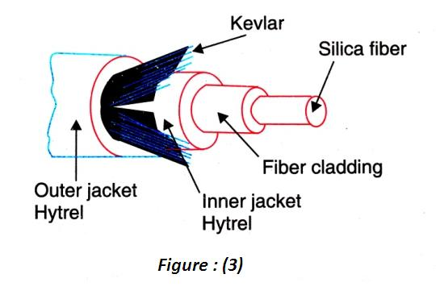
Single Fibre Cable:
Around the fibre a tight buffer jacket of Hytrel is used as shown in the figure.

Slide 20
The buffer jacket Protects the fibre from moisture and abrasion.
A strength member is arranged around the buffer jacket in order to provide the necessary toughness and tensile strength.
The strength may be provided by a steel wire, polymer film, nylon yarn or Kevlar yarn.
Then the fibre cable is covered by a Hytrel outer jacket.
Because of this arrangement fibre cable will not get damaged during bending , rolling , stretching, pulling, during transportation and installation processes.
The single fibre cable is used for indoor applications.

Slide 21
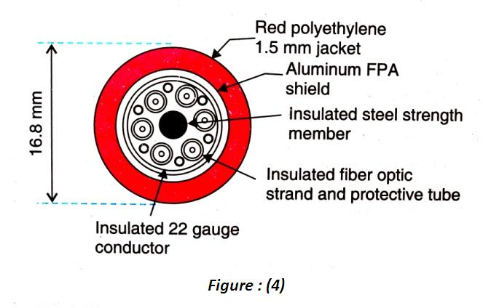
Multifibre Cable:
A multiple cable consists of number of fibers in a single jacket. Each fibre carries light independently. The cross-sectional view of a typical telecommunication cable is shown in figure 4

Slide 22
It contains six optical fibre strands and has an insulated steel cable at the centre for providing tensile strength.
Each optical fibre strand consists of a core surrounded by a cladding, which in turn is coated with insulating jacket.
The fibre are thus individually buffered and strengthened.
Six insulated copper wires are distributed in the space between the fibre.
They are used for electrical transmission , if required.
The assembly is then fitted within a corrugated aluminum sheath, which acts as a shield.
A polyethylene jacket is applied over the top.

Slide 23
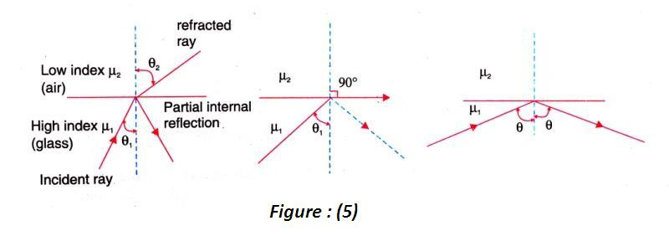
Total Internal Reflection
A medium having a lower refractive index is called rare medium while a medium having higher refractive index is known as denser medium.

Slide 24

when a ray of light passes from denser medium to rare medium, it is bent away from the normal in the rare medium.
Snell’s law is
where θ₁ is the angle of incidence of light ray in the denser medium
θ₂ is the angle of refraction in the rare medium .

Slide 25
If θ₁ ∠ θ_{c ,} the ray refracts into the rare medium
If θ₁ = θ_{c ,} the ray just grazes the interface of rarer-to-denser media.
If θ₁ > θ_{c ,} the ray is refracted back into the denser medium
The phenomenon in which light is totally reflected from a denser –to-rare medium boundary is known as total internal reflection.
The rays that experience total internal reflection obey the laws of reflection.
Therefore, the critical angle can be determined from Snell’s law.

Slide 26




When
Therefore, from equation, we get
when the rare medium is air , μ₂ =1 and writing μ₁ ₌ μ
we get

Slide 27
PROPAGATION OF LIGHT THROUGH AN OPTICAL FIBRE:
The diameter of an optical fibre is very small
We can not use bigger light sources for launching light beam into it.
Light emitting diode (LFD) and LASER diodes are the optical sources used in fiber optics
In case of these small sized sources, a focusing lens has to be used to concentrate the beam on to the fibre core.

Slide 28
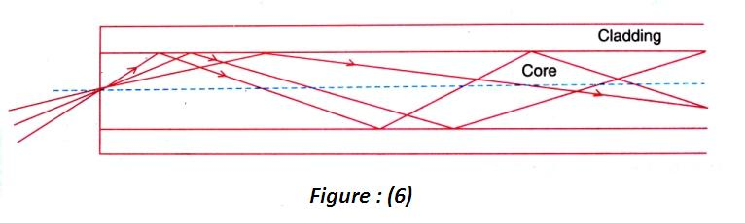


Slide 29
Light propagate as an electromagnetic wave through an optical fibre.
However, light propagation through an optical fiber can as well be understood on the basis of ray model.
According to the ray model, light rays entering the fibre strike the core at different angles.
As the refractive index of the cladding is less than that of the core, majority of the rays undergo total internal reflection at the interface and the angle of reflection is equal to the angle of incidence in each case.

Slide 30
Since each reflection is a total internal reflection
There is no loss of light energy and light confines itself within the core during the propagation.
Because of the negligible loss during the total internal reflections, optical fibre can carry the light waves over very long distances.
Thus , the optical fibre acts essentially as wave guide and is often called a light guide or light pipe.
At the exit end of the fibre, the light is received by a photo-detector.

Slide 31
For total internal reflection at the fibre wall following
two conditions must be satisfied.
The refractive index of the core material n₁ , must be slightly greater than that of the cladding n₂.
At the core –cladding interface, the angle of incidence θ between the ray and the normal to the interface must be greater than the critical angle θc defined by

Slide 32
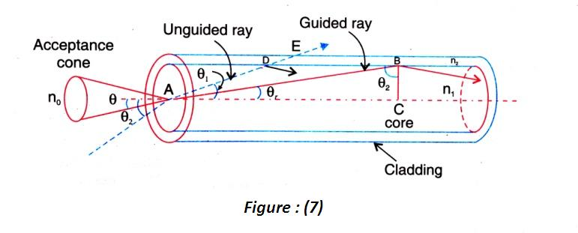
Critical Angles of Propagation:
Consider a step index optical fibre into which light is launched at one end. The end at which light enters the fibre is called launching end.

Slide 33
In a step-index fibre, the refractive index changes from the core to the cladding.
Now, we consider two rays entering the fibre at two different angles of incidence.
The ray shown by the broken line is incident at an angle θ₂ with respect to the axis of the fibre.
This ray undergoes refraction at point A on the interface between air and the core.
The ray refracts into the fibre at an angle θ₁ (θ_{1∠} θ₂).

Slide 34
The ray reaches the core –cladding interface point at D.
At point D, refraction takes place again and the ray travels in the cladding.
Finally, at point E, the ray refracts once again and emerges out of fibre into the air.
It means that the ray does not propagate through the fibre.

Slide 35

Now consider the ray shown by the solid line
The ray incident at an angle θ undergoes refraction at point A on the interface and propagates at an angle θ_{c} in the fibre.
At point B on the core-cladding interface, the ray undergoes total internal reflection, since n₁ > n_{2. ­}
Let us assume that the angle of incidence at the core-cladding interface is the critical angle θ_{c ,} where θ_{c} is given by

Slide 36
A ray incident with an angle larger than θ_{c} will be confined to the fibre and propagate in the fibre.
A ray incident , at the core-cladding boundary, at the critical angle is called critical ray.
The critical ray makes an angle θ_{c} with axis of the fibre.
It is obvious that rays with propagation angles larger than θ_{c} will not propagate in the fibre.
Therefore, the angle θ_{c} is called the critical propagation angle.

Slide 37





Thus , only those rays which are refracted into the cable at angles θ_{r ∠} θ_{c} will propagate in the optical fibre.

Slide 38
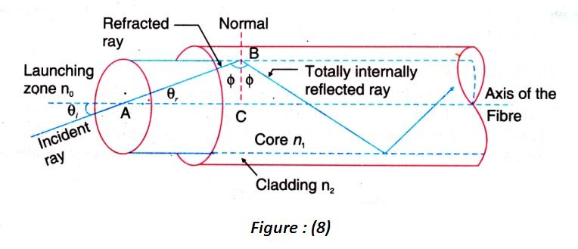
Acceptance Angle:
Considering a step index optical fibre into which light is launched at one end. Let the refractive index of the core be n₁ and the refractive index of the cladding be n₂ (n₂ < n₁).
Let n₀ be the refractive index of the medium from which light is launched into the fibre.

Slide 39

The light ray enters the fibre an angle θ_{i}
The ray refracts at an angle θ_{r} and strikes the core-cladding interface at an angle ф.
If ф is greater than critical angle ф_{c}, the ray undergoes total internal reflection, since n₁ > n₂.
When the angle ф is greater than ф _{c,} the light will stay within the fibre.
Applying Snell’s law to the launching face of the fibre, we get
---------------(1)

Slide 40


If θ_{i} is increased beyond a limit, ф will drop below the critical value ф_{c} and the ray escapes from the sidewalls of the fibre.
The largest value of θ_{i} occurs when ф = ф_{c} .
In Δ^{le} ABC
----------(2)
Using eq(2) in (1), we get
-----------------(3)

Slide 41






Slide 42



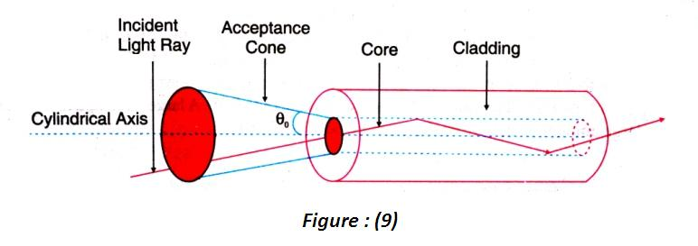

Slide 43
The angle θ₀ is called the acceptance angle of the fibre.
Acceptance angle is the maximum angle that a light ray can have relative to the axis of the fibre and propagate down the fibre.
When angles less that θ₀ will undergo repeated total internal reflections and reach the other end of the fibre.
Hence, larger acceptance angles make it easier to launch light into fibre.
In three dimensions, the light rays contained within the cone having a full angle 2θ₀ are accepted and transmitted along the fibre
Therefore, the cone is called the acceptance cone. Light incident at an angle beyond θ₀ refracts through the cladding and corresponding optical energy is lost.

Slide 44

Fractional Refractive Index Change:
The fractional difference Δ between the refractive indices of the core and the cladding is known as the fractional refractive index change.
It is given by
The value of Δ is always positive because n₁ must be greater than n₂ for the total internal reflection condition.
In order to guide light rays effectively through a fibre, Δ<<1 and Δ is of the order of 0.01

Slide 45





Numerical aperture
The numerical aperture NA is defined as the sine of the acceptance angle.

Slide 46




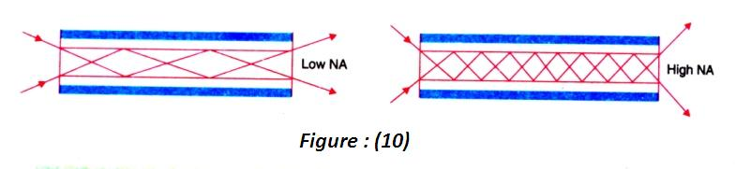
Numerical aperture determines the light gathering ability of the fibre. It is a measure amount of light that can be accepted by a fibre

Slide 47
Modes of Propagation:
The light propagates as an electromagnetic wave through an optical fibre
Maxwell’s equations.
Requires a complete understanding of solution
When a plane electromagnetic wave propagates in free space, it travels as a transverse electromagnetic waves.
The electric field and magnetic field components associated with the wave are perpendicular to each other and also perpendicular to the direction of propagation.
It is known as a TEM wave.

Slide 48
But, when the light ray is guided through an optical fibre, it propagates in different types of modes.
Each of these guided modes consists of a variety of electromagnetic field configurations
Transverse electric TE, Transverse magnetic TM , Hybrid modes.
Hybrid modes are combinations of transverse electric and magnetic modes.
In simple terms, these modes can be visualized as the possible number of allowed paths of light in an optical fibre as shown in figure 6.

Slide 49
All the paths are zigzag paths excepting the axial direction. The rays having propagation angles between θ=0⁰ and θ = θ_{c} will be in a position to undergo total internal reflections, all of them will not however propagate along the optical fibre.

Slide 50
As zigzag ray gets repeatedly reflect at the walls of the fibre, phase shift occurs.
The waves traveling along certain zigzag paths will be in phase and undergo constructive interference
While the waves along certain other paths will be out of phase and diminish due to destructive interference .
The light ray paths along which the waves are in phase inside the fibre are known as modes.
Increasing the core refractive index increases the number of propagating modes.
Increasing the clad refractive index decreases the number of propagating modes.

Slide 51
The number of modes depends on the ratio d/λ
where d is the diameter of the core and λ is the wave length of the wave
The zero order ray travels along the axis in known as the axial ray.
Note that each mode carries a portion of the light from the input signal.
Types of modes:
The modes that propagate at angles close to critical angle ф_{c} are higher order modes
The modes that propagate with angles larger than the critical angle are lower order modes

Slide 52
In case of lower order modes , the fields are concentrated near the centre of the fibre.
In case of higher order modes, the fields are distributed more towards the edge of the wave-guide
This mode of tend to send light energy into the cladding.
This energy is lost ultimately.
The higher order modes have to traverse longer paths and hence take larger time than the lower order modes to cover a given length of the fibre.
Thus, the higher order modes arrive at the output end of the fibre later than the lower order modes.

Slide 53
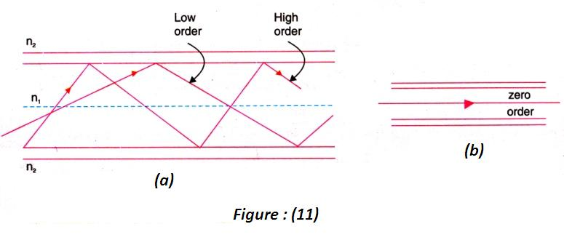

Slide 54
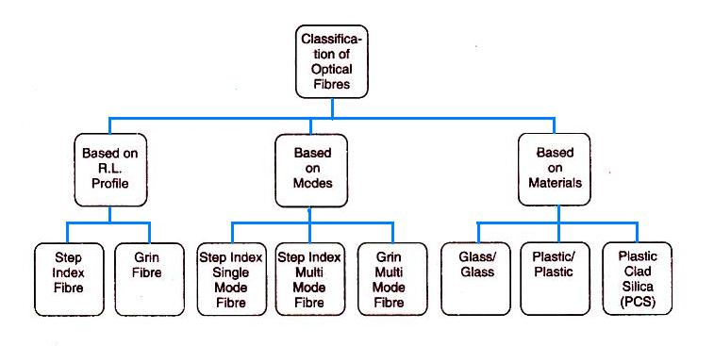
Classification of optical fiber

Slide 55
Classification basing on refractive index profile
Step index fibres: The refractive index of the core is constant along the radial direction and sudden falls to a lower value at the cladding and core boundary
Graded index(GRIN) fibres: The refractive index of the core is not constant but varies smoothly over the diameter of the core
It has a maximum value at the centre and decreases gradually towards the outer edge of the core.
At the core-cladding interface the refractive index of the core matches with the refractive index of the cladding
The refractive index of the cladding is constant.

Slide 56
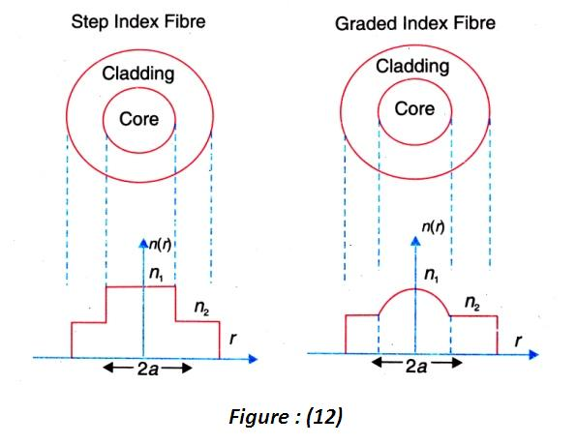

Slide 57
Classification basing on the modes of light propagation
(a) Single mode fibre (SMF)
(b) Multimode fibre (MMF)
Single mode fibre (SMF) has a smaller core diameter and can support only one mode of propagation.
Multimode fibre (MMF): A multimode fibre has a larger core diameter and supports a number of modes.
There is one more mode which is also multimode is Graded index(GRIN) fibre.

Slide 58
Classification basing on materials
This classification deals with the materials used for core and cladding.
The optical fibres, under this consideration are classified in to three categories.
Glass/glass fibres (glass core glass cladding)
Plastic/plastic fibres (plastic core with plastic cladding)
PCS fibres (polymer clad silica)

Slide 59
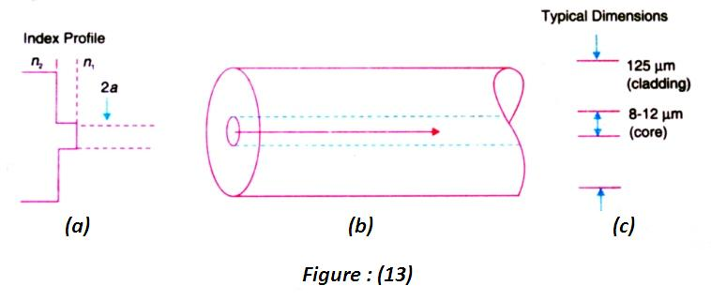
The three types of fibers
Single mode step index fiber
structure

Slide 60
Structure: A single mode step index fibre has a very fine thin core of diameter of 8μm to 12μm
It is usually made of germanium doped silicon. The core is surrounded by a thick cladding of lower refractive index.
The cladding is composed of silica lightly doped with phosphorous oxide.
The external diameter of the cladding is of the order of 125μm.
The fibre is surrounded by an opaque protective sheath.
The refractive index of the fibre changes suddenly at the core-cladding boundary.

Slide 61


The variation of the refractive index of a step index fibre as a function of radial distance be mathematically represented as

Slide 62
Propagation of light in SMF
Light travels in SMF along a single path that is along the axis as shown in figure
It is the zero order mode that is supported by a SMF
Both Δ and N A are very small for single mode fibres.
This small value is obtained by reducing the fibre radius and by making Δ to be small.
The low N A means low acceptance angle.
Therefore, light coupling into the fibre becomes difficult.
Costly laser diodes are needed to launch light into SMDF.

Slide 63
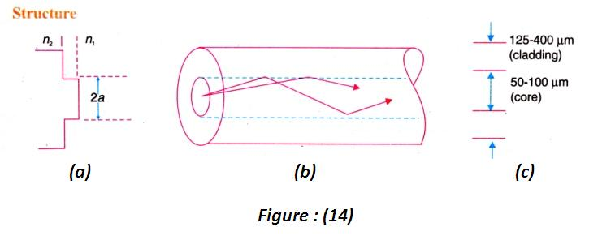
Multi mode step index fiber
structure

Slide 64
Structure:
The figure shows (a) its R.I. profile, (b) Ray paths (c) typical dimensions.
A multimode step index fibre is very much similar to the single mode step index fibre except that its core is of larger diameter.
The core diameter is of the order of 50 to 100μm, which is very large compared to the wavelength of light.
The external diameter of cladding is about 150 to 250μm.

Slide 65
Propagation of light in MMF:
Multimode step index fibre allows finite number of guided modes.
The direction of polarization, alignment of electric and magnetic fields will be different in rays of different modes.
Many zigzag paths of propagation are permitted in a MMF.
The path length along the axis of the fibre is shorter while the other zigzag paths are longer.
The lower order modes reach the end of the fibre earlier while the high order modes reach after some time delay

Slide 66
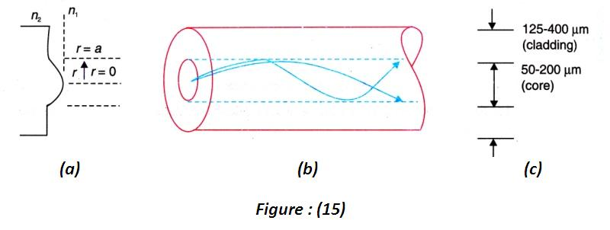
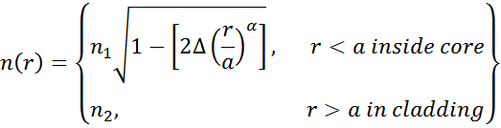
Graded index (grin) fiber
structure

Slide 67
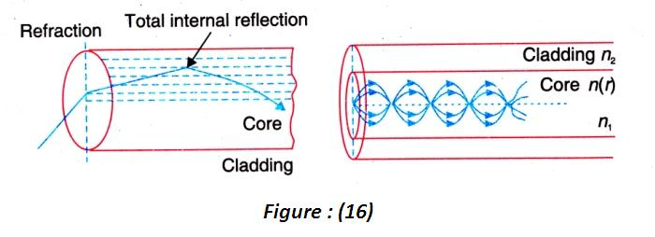


Propagation of light in SMF

Slide 68
Materials:
Optical fibres are fabricated from glass or plastic which are transparent to optical frequencies. Step index fibres are produced in three forms:
A glass core cladded with a glass having a slightly lower refractive index,
A silica glass core cladded with plastics and
A plastic core cladded with another plastic.
Generally the refractive index step is the smallest for all
glass fibres, a little larger for the plastic clad Silica PCS
(fibres) and the largest for all plastic construction.

Slide 69
All Glass Fibres:
The basic material of optical fibres is silica (SiO₂). It has a refractive index of 1.458 at λ=850nm.
The materials of different refractive index are obtained by doping silica material with various oxides.
If the silica is doped with Germania (GeO₂) or phosphorous pentoxide (P₂O₅), the refractive index of the material increases.
Such materials are used as core materials and pure silica is used as cladding material in these cases.

Slide 70
When pure silica is doped with boria (B₂O₃) or fluorine, its refractive index decreases.
These materials are used for cladding when pure silica is used as core material.
The examples for fibre compositions are
SiO₂ core – B₂O₃.SiO₂ cladding
GeO₂.SiO₂ core – SiO₂ cladding

Slide 71
All Plastic Fibres:
In these fibres, Perspex (PMMA) and polysterene are used for core. Their refractive indices are 1.49 and 1.59 respectively.
A fluorocarbon polymer or a silicone resin is used as a cladding material. A high refractive index difference is achieved between the core and the cladding materials.
Therefore, plastic fibres have large NA of the order of 0.6 and large acceptance angles up to 77º.
The main advantages of the plastic fibres are low cost and higher mechanical flexibility.

Slide 72
The mechanical flexibility allows the plastic fibres to have large cores, of diameters ranging from 110 to 1400μm.
They are temperature sensitive and exhibit very high loss.
Therefore, they are used in low cost applications and at ordinary temperatures (below 80ºC).
Examples of plastic fibres compositions are
1. Polysterene core n₁=1.60 NA=0.60
-Methyl methacrylate cladding n₂=1.49
2.Polymethyl methacrylate core n₁=1.49 NA=0.50
-cladding made of its copolymer

Slide 73
PCS Fibres:
The plastic clad silica (PCS) fibres are composed of silica cores surrounded by a low refractive index transparent polymer as cladding.
The core is made from high purity quartz.
The cladding is made of a silicone resin having a refractive index of 1.405 or perfluoronated ethylene propylene (Teflon) having a refractive index of 1.338.
Plastic claddings are used for step-index fibres only.
The PCS fibres are less expensive but have high losses. Therefore, they are mainly used in short distance applications.

Slide 74
Characteristics of Fibres:
Step index single mode fibre:
It has a very small core diameter, typically of about 10μm.
Its numerical apertures is very small
It supports only one mode in which the entire light energy is concentrated.
A single mode step index fibre is designed to have a V number between 0 and 2.4.
Because of a single mode of propagation, loss due to intermodal dispersion does not exist.

Slide 75
With careful choice of material, dimensions, and wavelength, the total dispersion can be made extremely small.
The attenuation is least.
The single mode fibres carry higher bandwidth than multimode fibres.
It requires a monochromatic and coherent light source. Therefore, laser diodes are used along with single mode fibres.

Slide 76
Advantages:
No degradation of signal
Low dispersion makes the fibre suitable for use with high data rates.
Single-mode fiber gives higher transmission rate and up to 50 times more distance than multimode.
Highly suited for communications.

Slide 77
Disadvantages:
Manufacturing and handling of SMF are more difficult.
The fibre is costlier.
Launching of light into fibre is difficult.
Coupling is difficult.
Applications:
Used as under water cables

Slide 78
Step-index multi-mode fibre:
It has larger core diameter, typically ranging between 50-100μm.
The numerical aperture is larger and it is of the order of 0.3
Larger numerical aperture allows more number of modes, which causes larger dispersion.
The dispersion is mostly intermodal.
Attenuation is high.
Incoherent sources like LEDs can be used as high sources with multimode fibres.

Slide 79
Advantages:
The multimode step index fibre is relatively easy to manufacture and is less expensive
LED or laser source can be used.
Launching of light into fibre is easier.
It is easier to couple multi-mode fibres with other fibres.
Disadvantages:
It has smaller bandwidth.
Due to higher dispersion data rate is lower and transmission is less efficient.
It is less suitable for long distance communications.
Applications:
Used in data links.

Slide 80
Graded-index multi-mode fibre:
Core diameter is in the range of 50-100μm.
Numerical aperture is smaller than that of step-index multimode fibre.
The number of modes in a graded index fibre is about half that in a similar multimode step-index fibre.
It has minimum attenuation.
Intermodal dispersion is zero, but material dispersion is present.
It has better bandwidth than multimode step-index fibre.

Slide 81
Advantages:
Either an LED or a laser can be used as the source of light with GRIN fibres.
Disadvantages:
The manufacture of graded index fibre is more complex. Hence, it is the most expensive fibre.
Coupling fibre to the light source is difficult.
Applications:
Used in telephone links.

Slide 82
Merits of Optical Fibre:
1. Cheaper:
Optical fibres are made from silica (SiO₂) which is one of the most abundant materials on the earth.
The overall cost of a fibre optic communication is lower than that of an equivalent cable communication system.
2. Smaller in size, lighter in weight, flexible and strong:
The cross section of an optical fibre is about a few hundred microns.
Hence, the fibres are less bulky. RG-19/U coaxial cable weights about 1100kg/km while a PCS fibre cable weights 6kg/km only.
Optical fibres are quite flexible and strong.

Slide 83
3. Not hazardous:
A wire communication link could accidentally short circuit high voltage lines and the sparking occurring thereby could ignite combustible gases in the area leading to a great damage.
Such accidents cannot occur with fibre links since fibre links are made of insulating materials.
4. Immune to EMI and RFI:
In optical fibre, information is carried by photons.
Photons are electrically neutral and cannot be disturbed by high voltage fields, lightening, etc.
Therefore, fibres are immune to externally caused background noise generated through electromagnetic interference (EMI) and radiofrequency interference (RFI).

Slide 84
5. No cross talk:
The light waves propagating along the optical fibre are completely trapped within the fibre and cannot leak out.
Light cannot couple into the fibre from sides.
In view of these features, possibility of cross talk is minimized when optical fibre is used. Therefore, transmission is more secure and private.
6. Wider bandwidth:
Optical fibres have ability to carry large amounts of information. While a telephone cable composed of 900 pairs of wire can handle 10,000 calls, a 1mm optical fibre can transmit 50,000 calls.

Slide 85
7. Low loss per unit length:
The transmission loss per unit length of an optical fibre is about 4dB/km. Therefore, longer cable-runs between repeaters are feasible.
If copper cables are used, the repeaters are to be spaced at intervals of about 2km. In case of optical fibres, the interval can be as large as 100km and above.
Disadvantages:
Installation and maintenance of optical fibres requires a new set of skills. They require specialized and costly equipment like optical time domain reflectometers etc. All this means heavy investment.

